Slide 1


School Management System: A Java Application
This presentation outlines the architecture and functionality of a simple School Management System developed in Java. We will explore its core components, user roles, and key features, demonstrating how it streamlines student and administrative tasks.
by Harsh Lawaniya

Slide 2
Core Components: Student Class
Student Attributes
Key Methods
The Student class encapsulates essential information for each student, including a unique ID, name, and grade. This structured approach ensures data integrity and easy access to student records.
Constructor: Initializes a new student object with provided ID, name, and grade.
getName(): Retrieves the student's name.
getGrade(): Retrieves the student's grade.
displayInfo(): Prints all student details to the console in a formatted manner.

Slide 3





Core Components: StudentManager Class
Add Student
Manages the creation of new student records, assigning unique IDs and validating grade inputs to ensure they are between 0 and 100.
View All Students
Provides a comprehensive list of all registered students, displaying their ID, name, and grade. It handles cases where no students are present.
View Student Grade
Allows users to search for a student by name and retrieve their specific grade. It includes error handling for unfound students.
Student Exists Check
A utility method to verify if a student with a given name already exists in the system, preventing duplicate entries.

Slide 4

Core Components: Admin Class
Secure Login
Admin Code
The Admin class provides a secure login mechanism for administrators using a predefined admin code. This ensures that only authorized personnel can access administrative functionalities.
A fixed admin code ("001") is used for authentication. Successful login grants access to the admin panel, while incorrect codes result in an error message.
Welcome Message
Upon successful login, a personalized welcome message is displayed to the administrator, enhancing the user experience.

Slide 5





System Flow: Main Menu
Welcome Screen
The initial entry point for all users, presenting options for Admin Login, Student Login, or exiting the system.
Admin Login
Directs to the admin authentication process, requiring a name and a specific admin code.
Student Login
Leads to the student registration/login process, where students can enter their name and grade.
Exit Application
Terminates the program, providing a graceful exit message to the user.

Slide 6
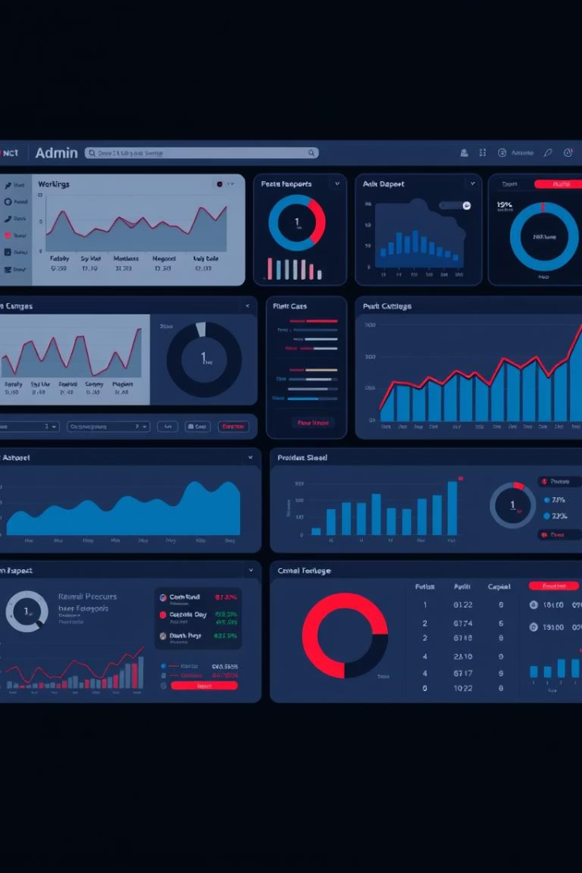
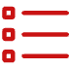


Admin Panel Functionality
View All Students
View Student Grade
Back to Main Menu
Admins can access a complete list of all students registered in the system, including their IDs, names, and grades.
This feature allows administrators to quickly look up the grade of a specific student by entering their name.
Provides a convenient option for administrators to return to the main system menu after completing their tasks.

Slide 7
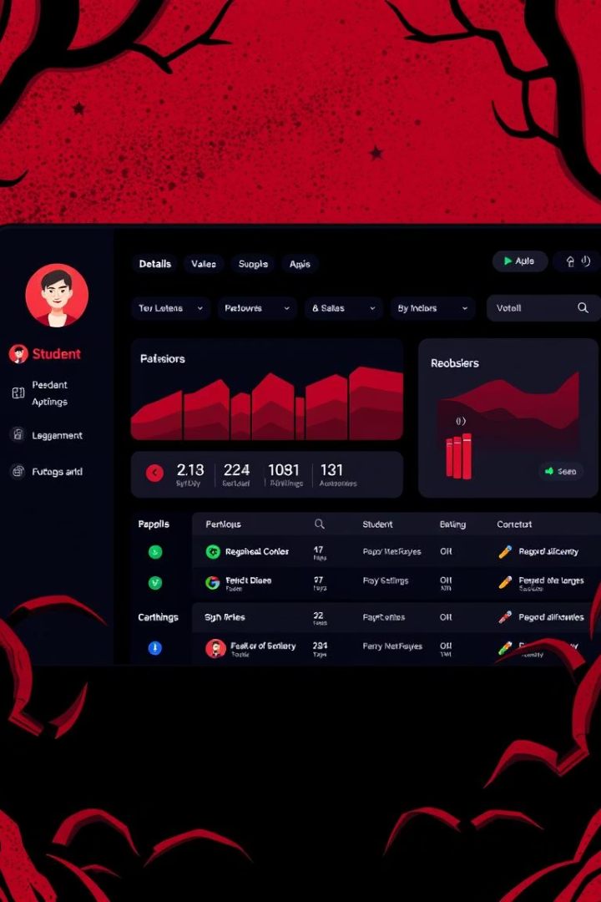
Student Panel Functionality
1
Student Login
Students enter their name and grade to register or access their panel. Grade input is validated to be between 0 and 100.
2
View My Details
Once logged in, students can view their own details, specifically their registered grade, ensuring transparency.
3
Exit to Main Menu
Students have the option to return to the main menu at any time, providing flexibility in navigation.

Slide 8


Key Takeaways and Next Steps
Modular Design
The system's modular design, with separate classes for Student, StudentManager, and Admin, promotes code organization and reusability.
User-Centric Interface
Both admin and student panels are designed for ease of use, with clear menu options and intuitive navigation.
Error Handling
Robust error handling for invalid inputs and unfound records ensures a stable and reliable user experience.
Future Enhancements
Potential future improvements include data persistence, more advanced search filters, and additional administrative controls.

Slide 9

Source Code :
Sfile:///D:/SMS.pdf

